Slide 1
Journey Planner
Artefacts Overview
Ammar Ahmad Wes Atkinson Ross Feeley Silvia Horoba

Slide 2
Summary
Project Initiation Document
Product and Work Breakdown Structures
Gantt Chart
Force Field Analysis
Business Case and Cost Benefit Analysis
Quality Plan and Software Quality Assurance
Project Management Strategy
Low fidelity prototype
Estimation
Risk Management
Responsibility (RACI matrix)
Project success/failure

Slide 3
Project Initiation Document
This Project Initiation Document (PID) has been created to define and gather essential planning information required to assess and manage a clear plan for the project delivery of the South Yorkshire Buses Journey Planner and its overall success. The document’s primary goal is to address the following fundamental aspects of the project:
What is the project aiming to achieve?
What is the project’s scope?
Who will be involved in managing the project, and what are their responsibilities?
How will risk be managed?
What are the constraints encountered?
How will quality be managed?
Notes:
silvia

Slide 4
Background of the Project
South Yorkshire Buses are a travel company based in South Yorkshire and require an application that will allow them to modernise their customers' travel experience. They need an application to compete with other companies around them that can adapt to modern technology allowing the users to plan their journeys on the go. The company’s current system is outdated, and it is not up to the current standards having multiple faults that cause inconvenience to their customers. The company is also looking to save money on hosting (that currently is going up to £60.000/year), on staff, and on any further updates that would usually cost up to £500/change.
Notes:
silvia

Slide 5
Objectives
This project aims to create an application that will use the South Yorkshire Buses bus schedule to allow customers to plan their journey effectively and efficiently. The system will need to provide the customers with the times and dates of all buses in the South Yorkshire area and will require us to create an application that can provide this service.
This system will use prototypes to manage the project so that we can get accurate feedback and information about our application to create the best product possible. The main objective is to build a high-quality product that will work fast and efficiently while keeping the lowest costs viable when it comes to maintaining it.
Notes:
silvia

Slide 6
Scope
Initially, the application will consist of features that will allow the user to check the times of buses around his area. The software will provide information such as when is my next bus, what buses are available at my location, and what is the best ticket to buy. The scope of the prototype is to allow users to choose their destination (either through a map or by adding the location manually) and be presented with a step-by-step route on how to get there through different modes of transportation (not only by bus). Furthermore, the system will provide live travel updates and alternative options in extenuating circumstances (e.g., road closures, accidents).
The ticketing system will be included in the final prototype, making it available for the users to check for the best price and purchase any ticket.
Notes:
silvia

Slide 7
Gantt Chart
We have taken into account the WBS, PBS, and Estimations to create the Gantt Chart.
The chart shows the breakdown of how long each staff will work at different parts of the final project over a period of 6 months.
For further development we will adjust timing so that multiple staff members will work on the same tasks at the same time.
Each task has been assigned a timeline of how long it will take to complete.
Notes:
wes

Slide 8
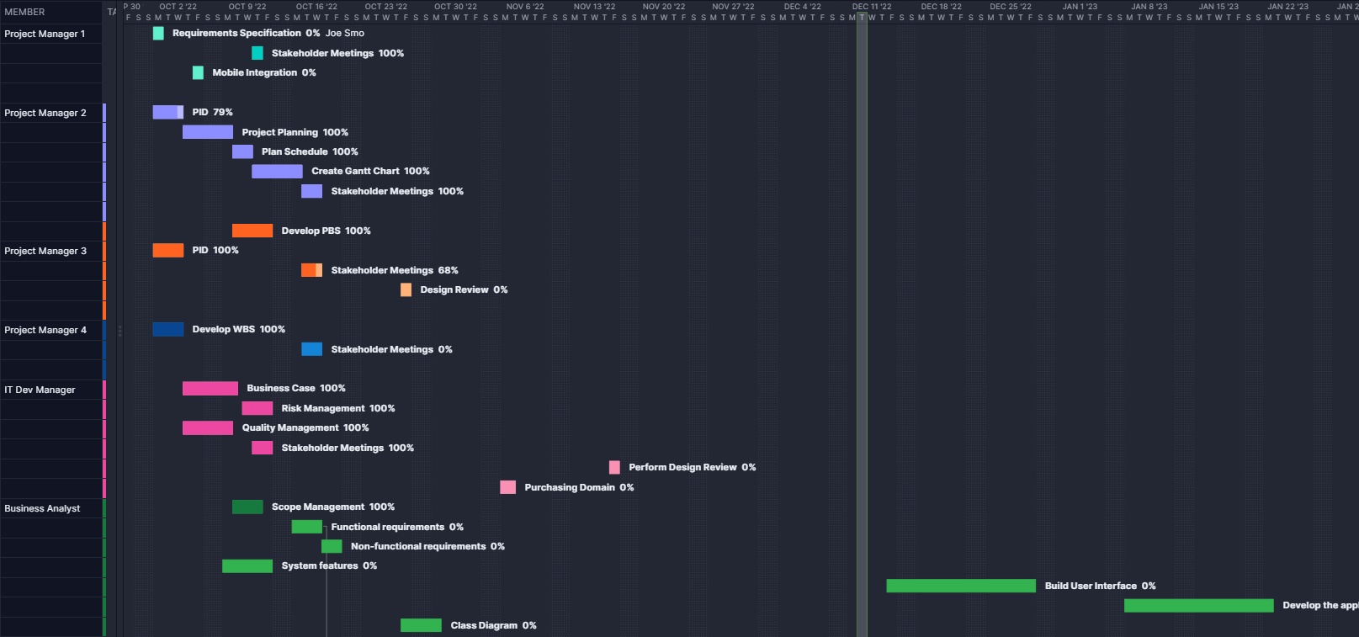

Slide 9
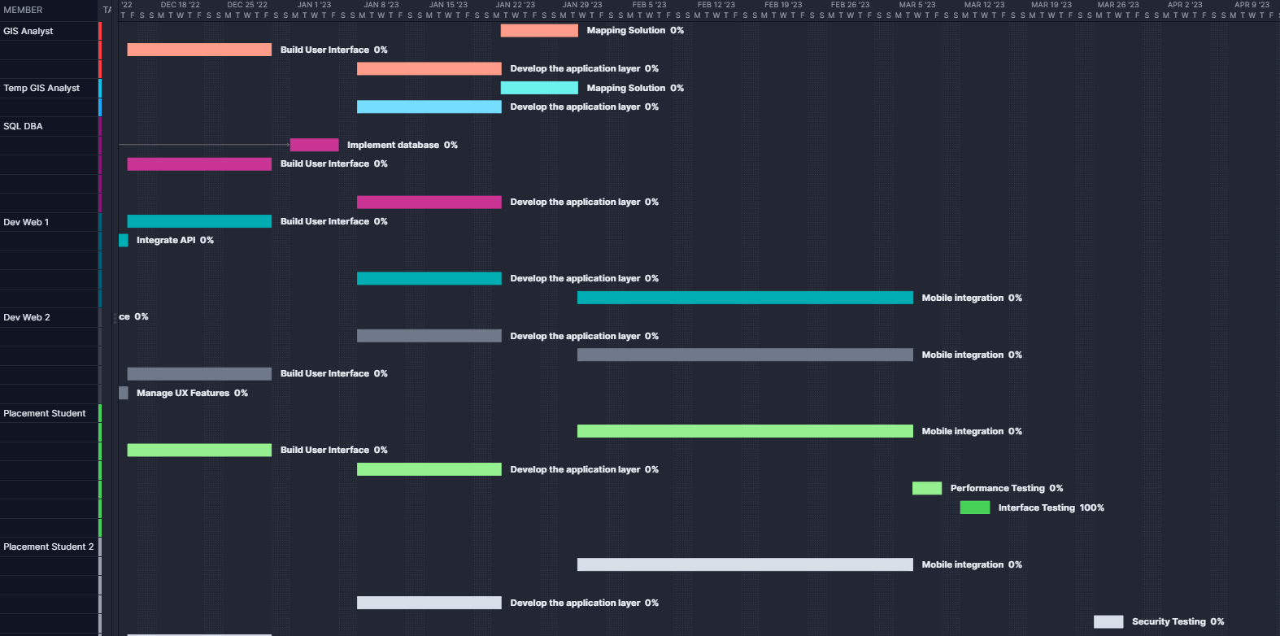

Slide 10
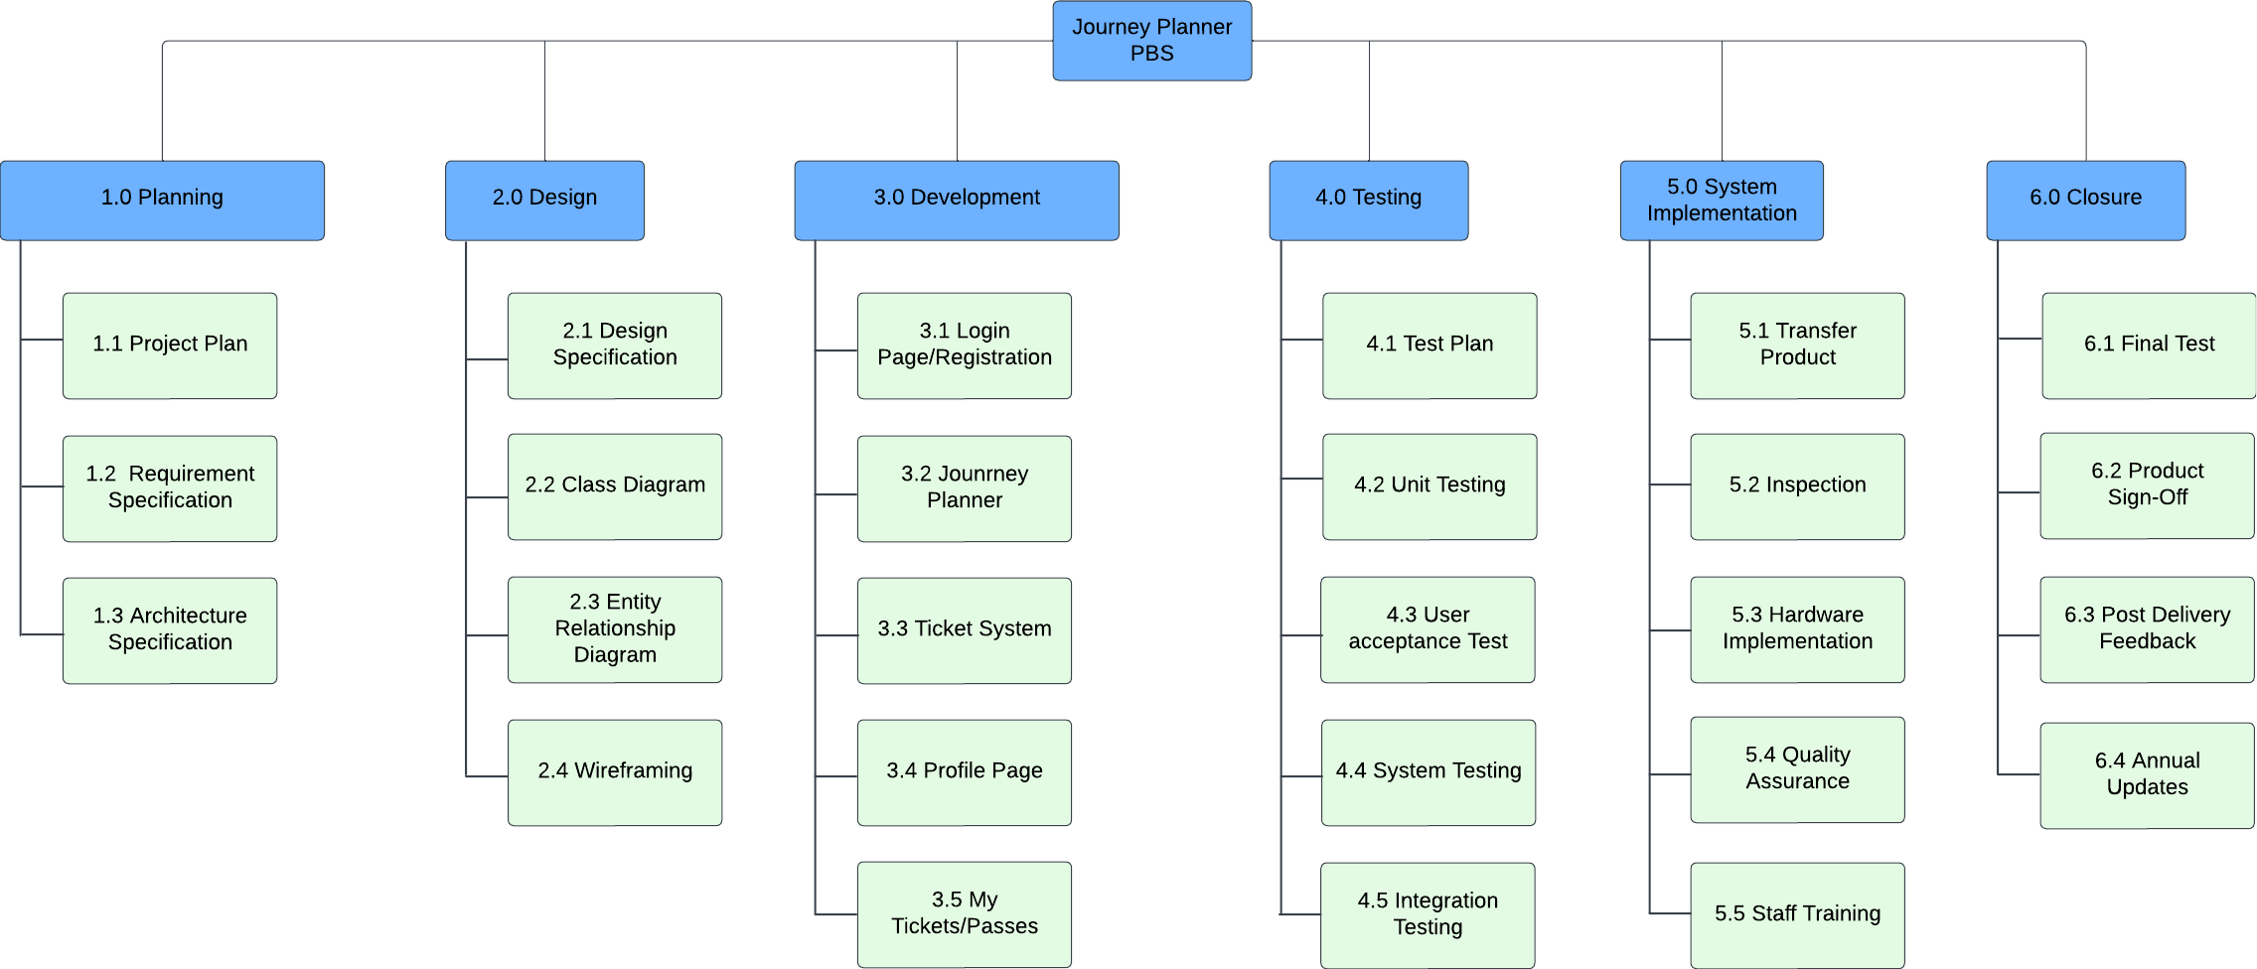
PBS
Notes:
ross

Slide 11
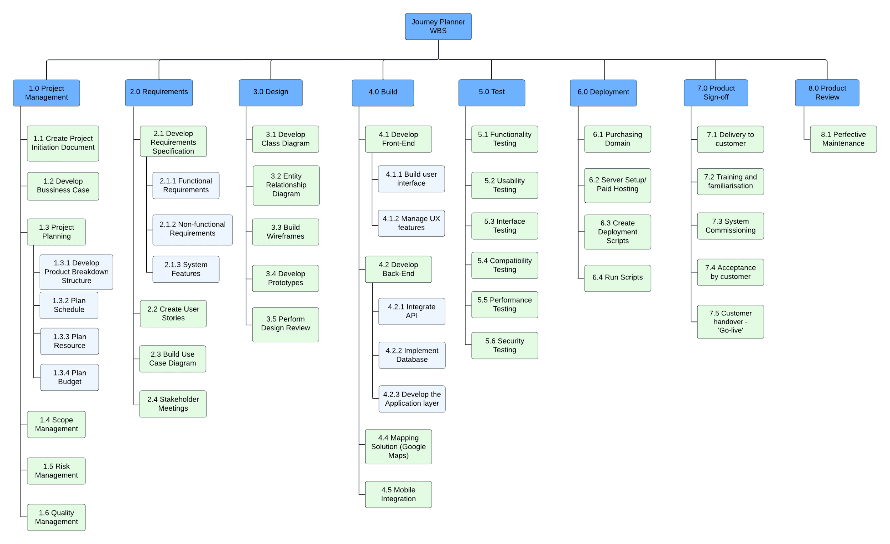
WBS
Notes:
ross

Slide 12
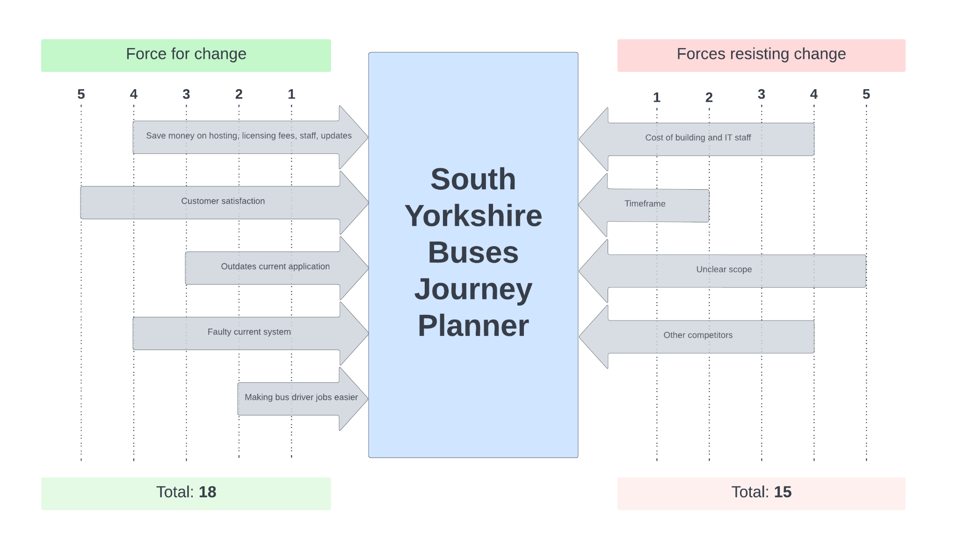
Force
Field Analysis
Notes:
silvia

Slide 13
Business Case
The time and cost of the application are the main problems this solution will address. The deadline for the journey planner is the 31st of March, 2023. It will be necessary to allocate staff accordingly to ensure the development process of this project reaches the intended date. This will reduce the cost spent on unwanted features. Following these procedures, the time and cost will not impact the application's overall quality.
Overall, the cheaper and more practical methods will allow us to break into a new market and increase the company's expenditures. We expect the company to lead to a high-profitable change, with profits expected to be 45% higher than the current solutions.
Notes:
ammar

Slide 14
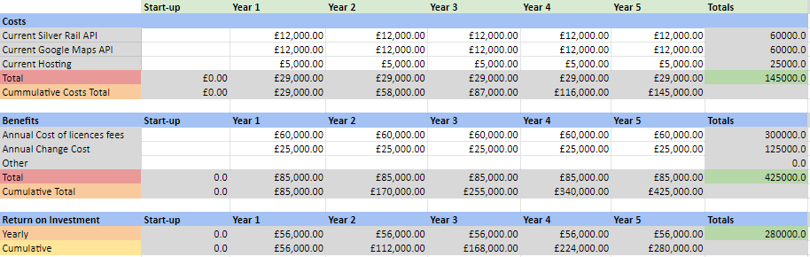
Cost Benefit Analysis
Notes:
wes

Slide 15
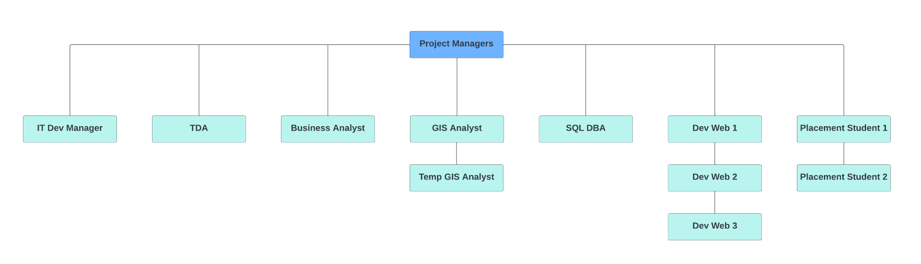
Quality Plan
Project organisation and responsibility
Notes:
ammar

Slide 16
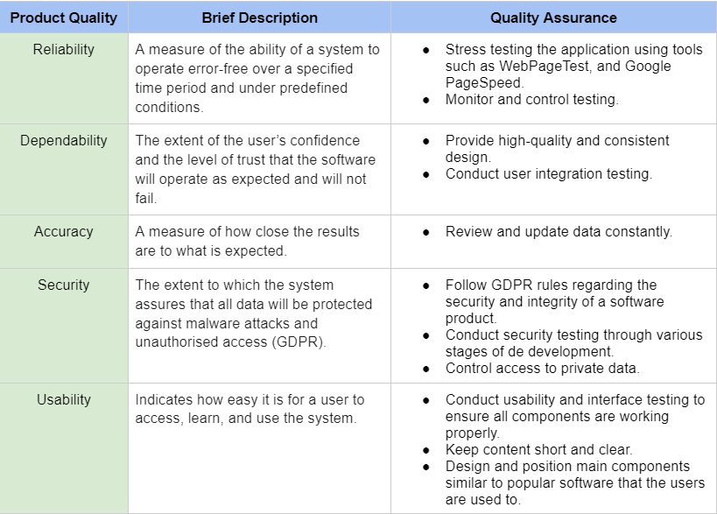
Quality requirements and assurance
Notes:
ammar

Slide 17
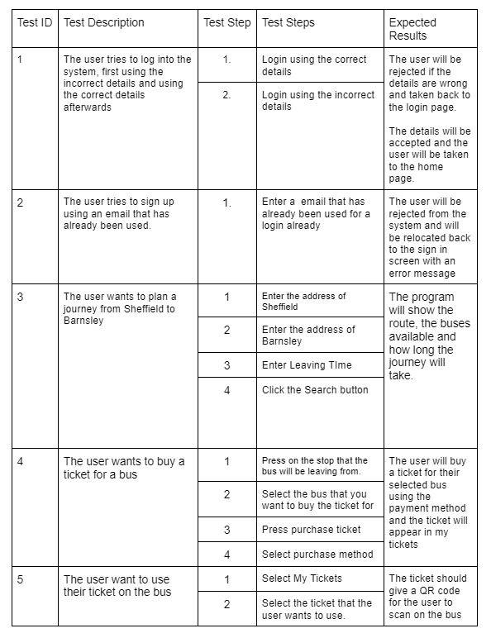
User Acceptance Tests
Notes:
ammar

Slide 18
Project Management Strategy
Reason for choosing water-scrum-fall
Water-Scrum-Fall is a methodology that combines the best elements of both Waterfall and Scrum. The combination consists of the strong beginning of Waterfall, meaning that a vast amount of research and requirements gathering is conducted before moving onto the cyclic, team-based approach used in Scrum. The Scrum team will have a solid, time-driven plan with a highly detailed roadmap they can stick to throughout the project duration.
Notes:
ross??

Slide 19
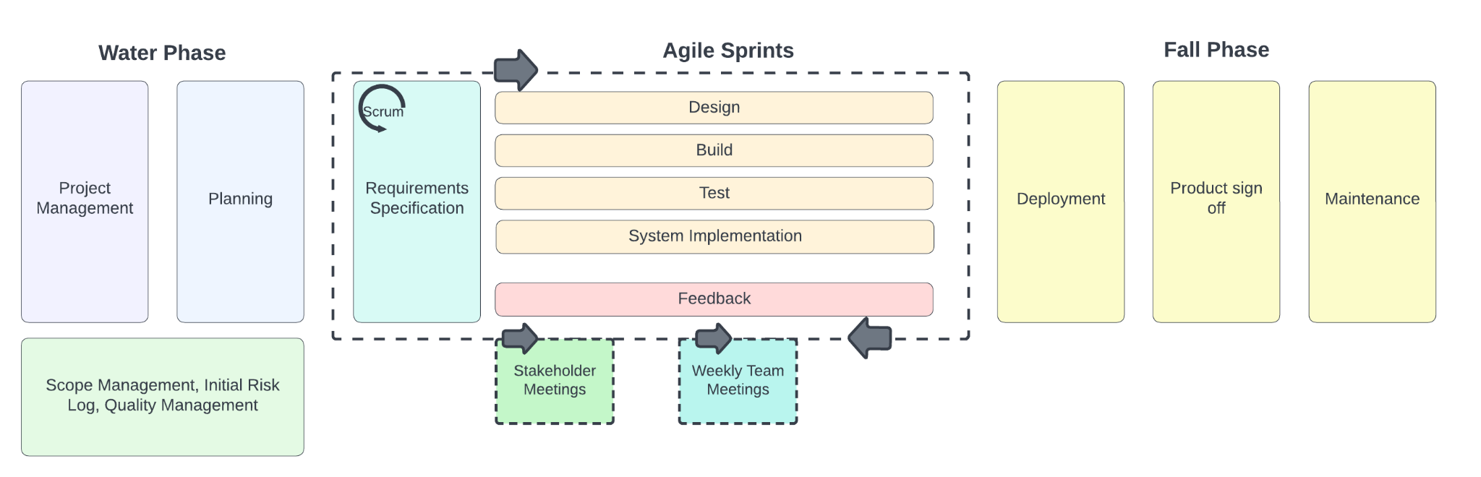
WBS aligning with water-scrum-fall
Notes:
silvia

Slide 20
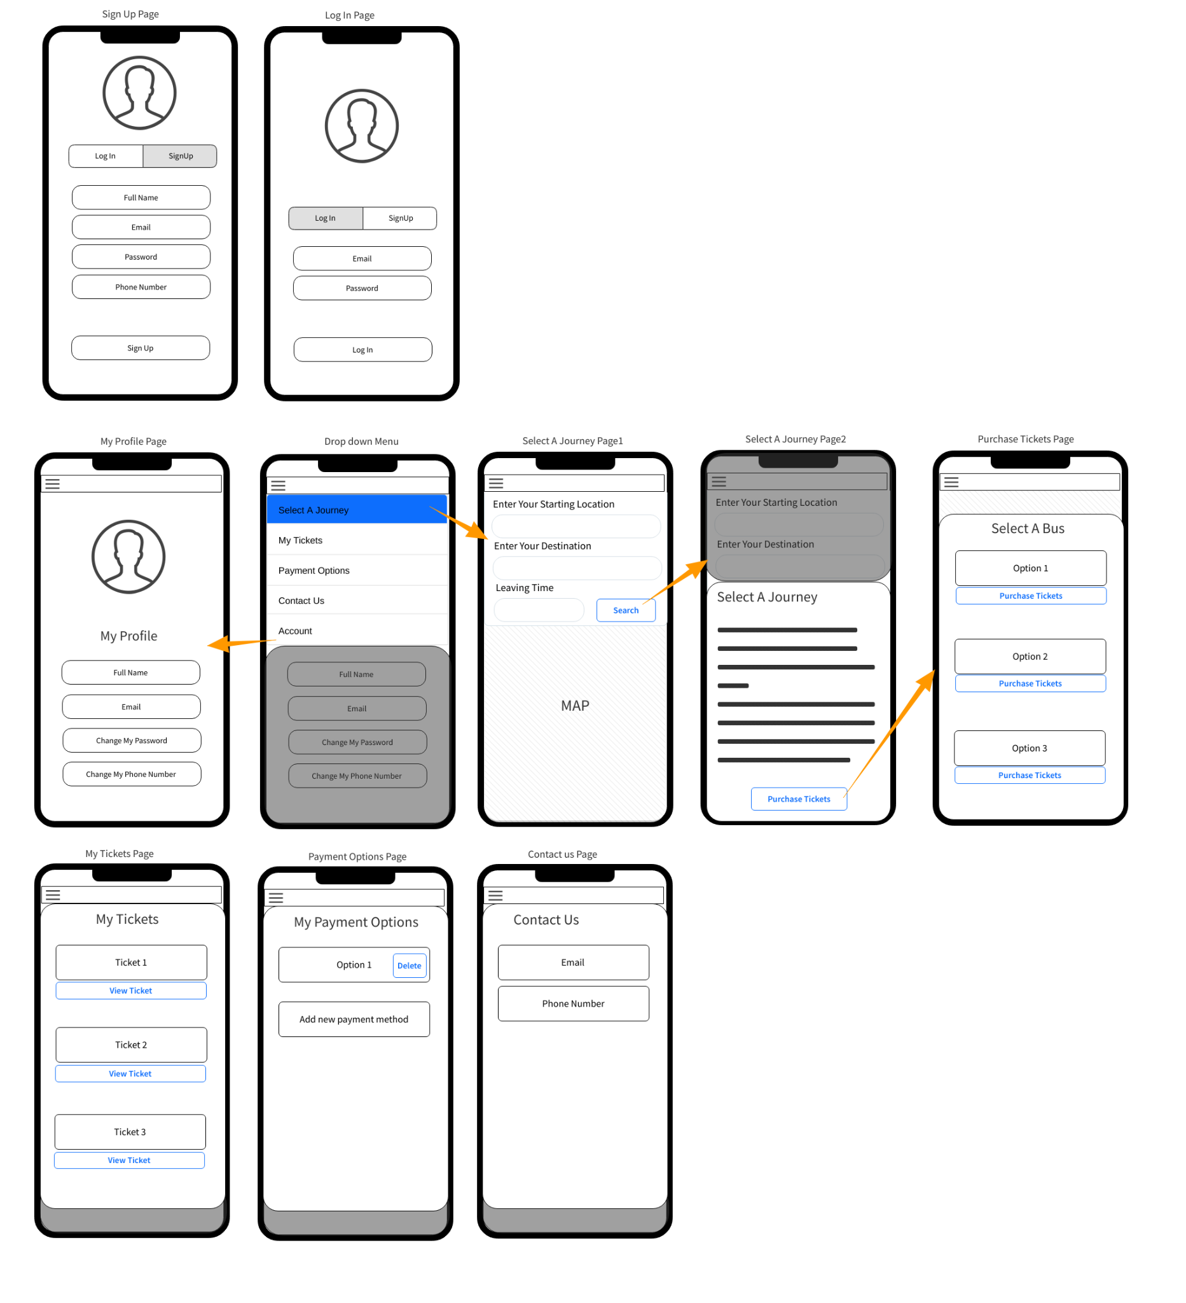
Low fidelity prototype
Notes:
ross??

Slide 21
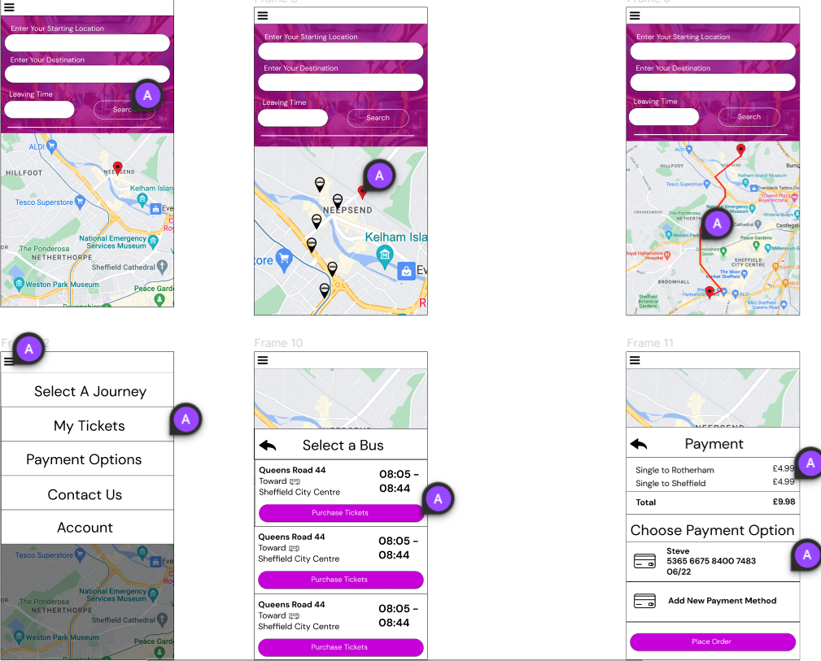
High Fidelity Prototype
Notes:
ross??

Slide 22
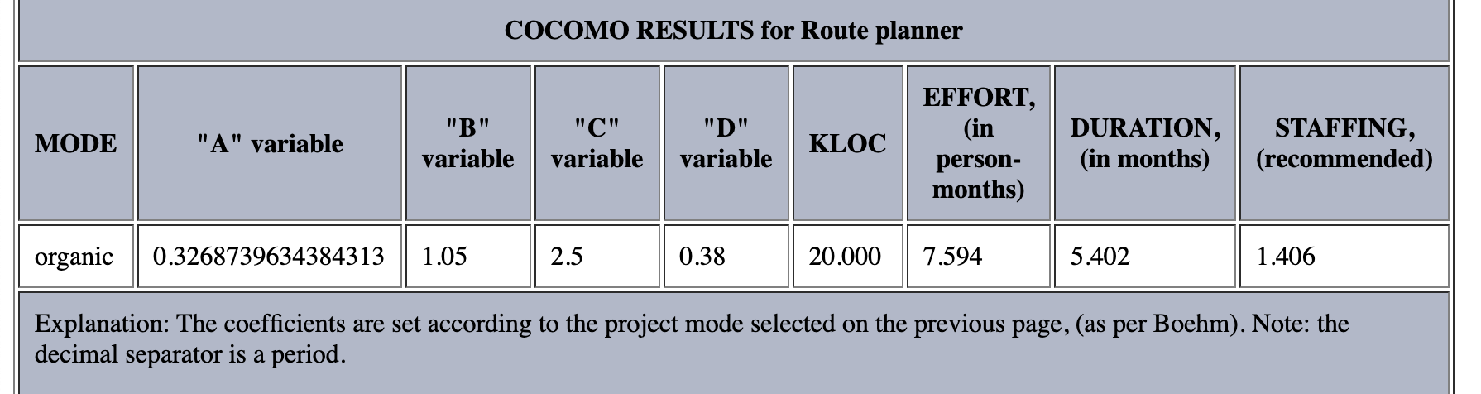
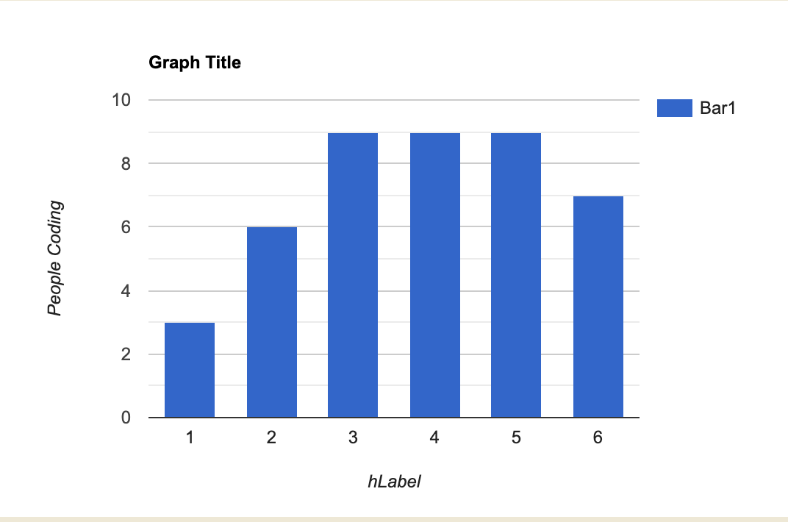
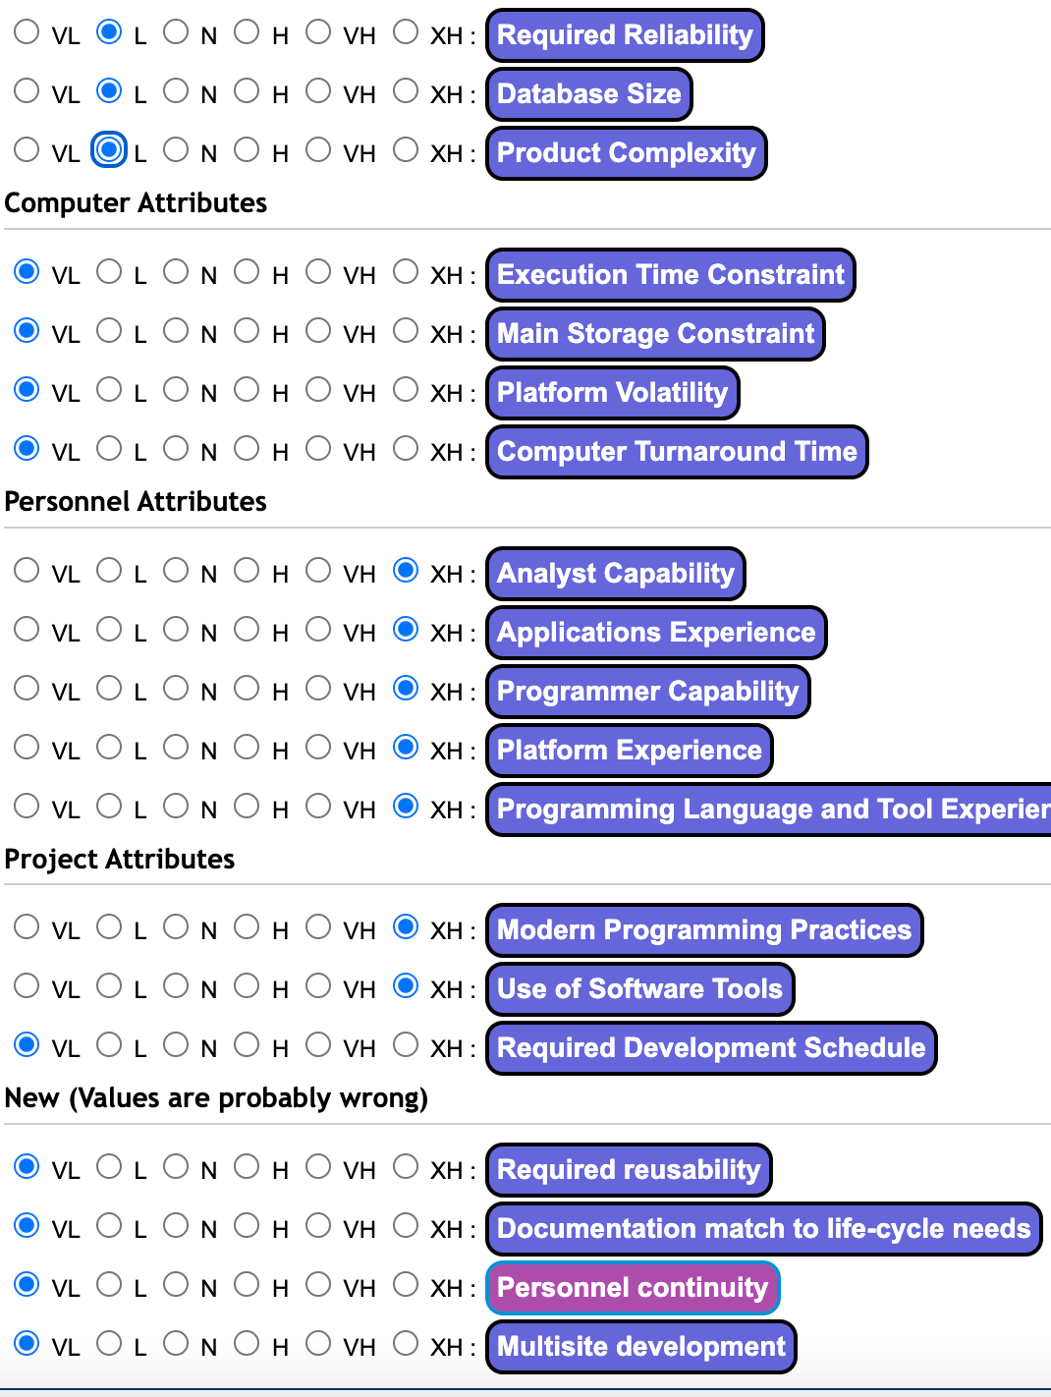
Estimation
Notes:
wes

Slide 23
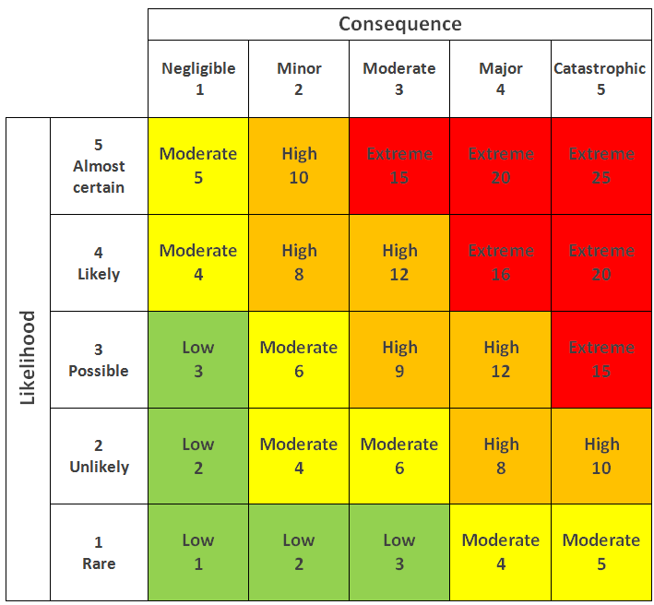
Risk Assessment Matrix
Notes:
wes

Slide 24
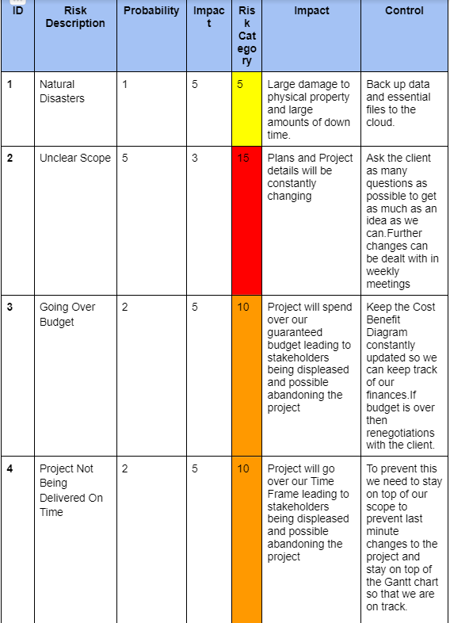
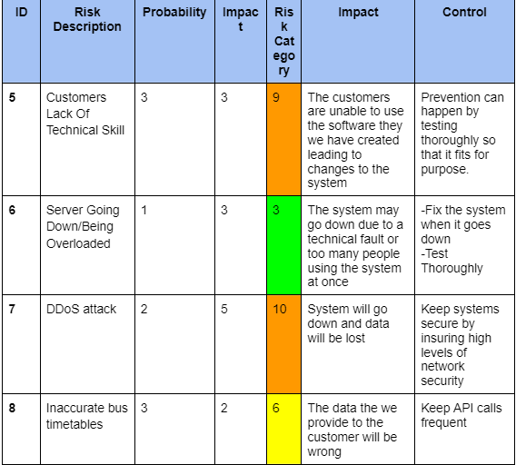
Risk Log
Notes:
wes

Slide 25
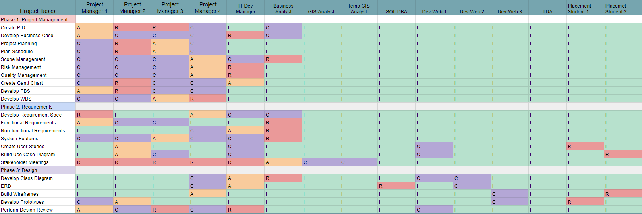
RACI Matrix
Notes:
wes

Slide 26
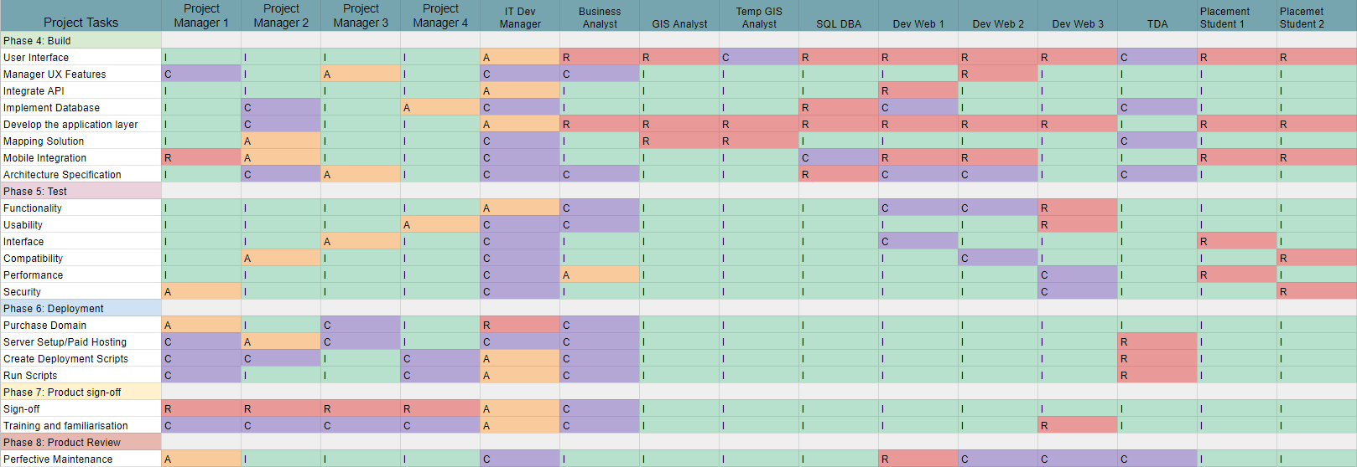
Notes:
wes

Slide 27
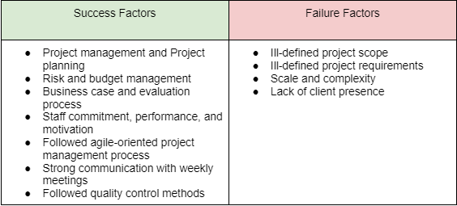
Project Success/Failure
Overall, the project ran very smoothly, and we eventually overcame all the challenges we encountered. Due to this, we consider the Journey Planner project a success.
Notes:
wes

